Slide 1

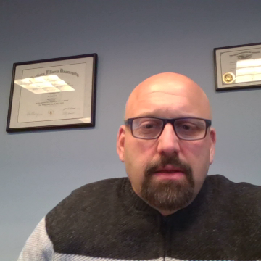
Illinois paid leave
FOR WORKERS LAWS as of 2025

Slide 2
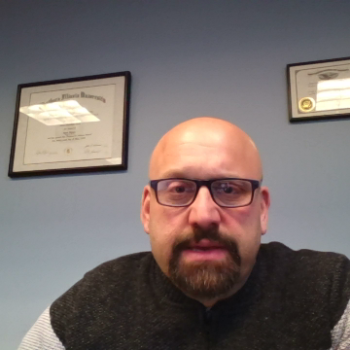
ILLINOIS PAID LEAVE FOR ALL WORKERS ACT
820 ILCS 192

Slide 3

ILLINOIS PAID LEAVE FOR ALL WORKERS ACT (PLAWA)
820 ILCS 192 – Effective January 1, 2024 https://www.ilga.gov/legislation/ilcs/ilcs3.asp?ActID=4351&ChapterID=68
General Provision: Requires employers to provide a minimum of 40 hours of paid leave during a 12-month period to be used by the employee for “any purpose.” 820 ILCS 192/15.
  Must be paid their normal hourly rate
Retaliation Provision: Prohibits employers from taking adverse action against an employee for exercising rights under the Act, opposing violations of the Act, or supporting others exercising rights under the Act. 820 ILCS 192/25
  This includes counting paid leave under a no-fault attendance policy
Employees can earn at least 1 hour of paid time off for every 40 hours worked
  Employees begin to accrue time at the commencement of employment (or on 1/1/2024)
  Employees must wait 90 days after their first day of work before taking paid leave
  Unused accrued leave can carry over to the next year

Slide 4
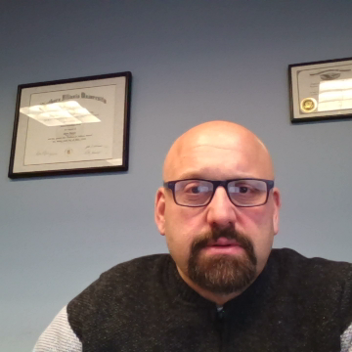
Who is covered under PLAWA?
Employees
Employers
PLAWA follows the definition of employee under IL Wage Payment and Collection Act
  Applies to full time, part time, seasonal, and temporary employees
  Does not apply to independent contractors
For FLSA overtime-exempt employees
  Hours worked in excess of 40/week are not counted
For FLSA non-exempt employees
  Hours worked in excess of 40/week are counted
PLAWA follows the definition of employee under IL Wage Payment and Collection Act
  Covers private employers of any size
  State & federal employers are exempt
Public school districts exempt

Slide 5
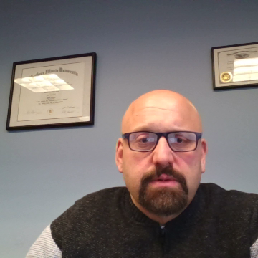
Filing a PLAWA Complaint
The IL Department of Labor enforces the Act. 820 ILCS 192/30(a).
  Employees cannot take a private right of action
Employees may file a complaint with IDOL within three years after the alleged violation. 820 ILCS 192/30(b)
Remedies include back pay, $2,500 in civil penalties, and equitable relief including attorney’s fees, witness fees, and other costs of the action.
COMPLAINT FORM:
  https://labor.illinois.gov/laws-rules/paidleave/paidleavecomplaintform.html

Slide 6
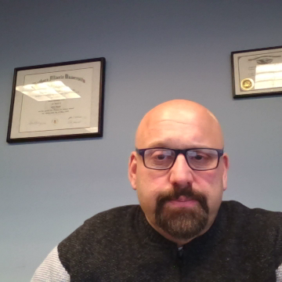

Slide 7
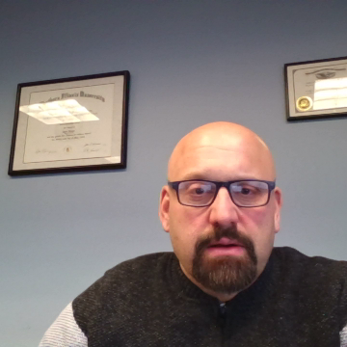
COOK COUNTY paid leave ordinance

Slide 8
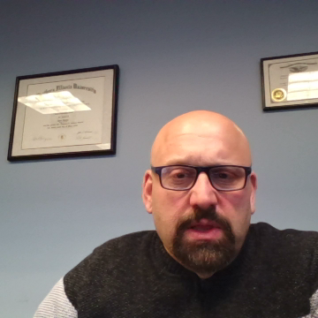
COOK COUNTY PAID LEAVE ORDINANCE
Effective 12/31/2023 https://www.cookcountyil.gov/sites/g/files/ywwepo161/files/documents/2024-01/24-0583%20Certified%20Full%20Text%20.pdf
General Provision: Requires employers provide with least 1 hour of paid leave for every 40 hours worked to be used for any reason. § 42-3.
  Employees are entitled to use leave after 90 days after the commencement of employment
  Employees are not required to give a reason or documentation for leave
  Unused leave shall carry over
Prohibits employers from taking adverse action against an employee for exercising rights under the Act, opposing violations of the Act, or supporting others exercising rights under the Act. § 42-7.
  This includes counting paid leave under a no-fault attendance policy

Slide 9
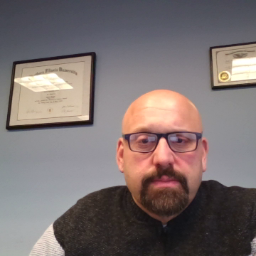
Who is covered under Cook County’s Ordinance
Employees
Employers
Does not apply to employees outside of Cook County (or employees within Chicago)
Employee is the same application as the IL Wage Payment and Collection Act (and PLAWA)
  Applies to full time, part time, seasonal, and temporary employees
  Does not apply to independent contractors
For FLSA overtime-exempt employees
  Hours worked in excess of 40/week are not counted
For FLSA non-exempt employees
  Hours worked in excess of 40/week are counted
Does not apply to employers outside of Cook County (or employers in Chicago)
Employer is the same application as the IL Wage Payment and Collection Act (and PLAWA)
  Covers private employers of any size
  State & federal employers are exempt

Slide 10

Filing a Cook County Paid Leave Complaint
Employees may recover through civil action or by filing a complaint with the Cook County Commission on Human Rights within 3 years of the alleged violation. § 42-8.
Potential remedies include damages equal to three times the full amount of paid leave denied/lost plus interest, with costs and reasonable attorney’s fees. § 42-8.
COMPLAINT FORM: https://ccchr.my.salesforce-sites.com/Forms/advpm__IntakeForm?formId=a0m8z000000SsC4AAK&formWidth=800px&hh=1

Slide 12
CHICAGO’S PAID LEAVE AND PAID SICK and safe LEAVE ORDINANCE

Slide 13
CHICAGO PAID LEAVE AND PAID SICK AND SAFE LEAVE ORDINANCE
Chicago, Ill. Municipal Code § 6-130-005 – Effective July 1, 2024 https://codelibrary.amlegal.com/codes/chicago/latest/chicago_il/0-0-0-2640051
General Paid Leave: Requires employers to provide a minimum 40 hours of paid leave during a 12-month period. 6-130-030.
  1 hour of paid leave accrues for every 35 hours worked
  Employees can use paid leave after 90 days after commencement of employment
  Up to 16 PL hours can be carried over
General Sick Leave: Requires employers to provide a minimum of 40 hours of paid sick leave for medical reasons for the employees and their families. 6-130-030
  1 hour of paid sick leave accrues for every 35 hours worked
  Employees can use paid leave after 30 days after commencement of employment
  Up to 80 hours can be carried over
This means 40 hours of Paid Leave and 40 hours of sick leave
Retaliation: No employer shall ”interfere with, deny, or change an employee’s work days or hours to avoid providing leave.” 6-130-020.
  Cannot use absence-control policy to count paid leave as an absence that triggers discipline, discharge, demotion, suspension, or any other adverse activity.

Slide 14
Who is covered under Chicago’s Ordinance
Employees
Employers
Does not apply to employees outside of Chicago
Applies to an employees who works at least 80 hours for an Employer within any 120-day period (while physically present in Chicago)
  This includes independent contractors!
  If employees is paid to travel to Chicago, that travel time accrues
Does not apply to employers outside of Chicago
Applies to any person who employs at least one person

Slide 15
Filing a Chicago Paid Leave Complaint
Employees can file a Complaint with the The Department of Business Affairs and Consumer Protection. 6-130-070.
COMPLAINT FORM: https://311.chicago.gov/s/service-request?language=en_US
Remedies include damages equal to three times the full amount of leave denied/lost with interest “at the prevailing rate,” and reasonable costs and attorney’s fees
Private Causes of Action: if any covered employee is not allowed a benefit to which entitled to under this chapter, they may recover in a civil action. 6-130-100
  For Paid Sick Leave: private cause of action available on 7/1/2024
  For Paid Leave: cannot seek private cause of action until 7/1/2025

Slide 17

SUMMARY
Check the employer’s location to determine the applicable laws and correct filing offices
The Chicago Ordinance is the only paid leave law that covers independent contractors
PLAWA does not offer a private right of action – but Chi and CC do!

